Slide 1

ReactJS Online Training
NARESH I TECHNOLOGIES

Slide 2
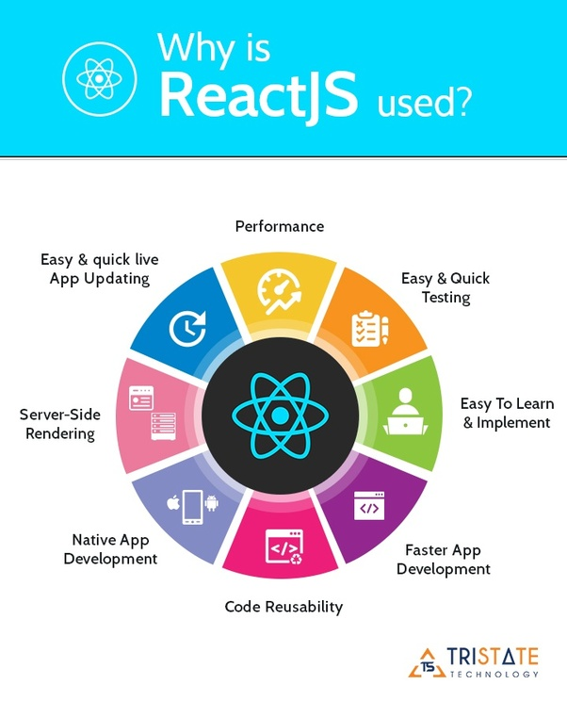
About ReactJS
ReactJS is a JavaScript library responsible for providing UI components for client-side development. ReactJS has a DOM( Document Object Layer) which helps it to be faster by refreshing only some part of the page which user views. ReactJS can be used for developing dynamic network applications, ReactJS is a library for building composable user interfaces. It encourages the creation of reusable UI components that present data that changes over time. It is not a complete application framework like angular, it is just a view layer. So it is not directly comparable to frameworks like angular.
Prerequisites:
Basic Knowledge of Javascript, HTML,
and CSS.
Fair Knowledge On basics of testing tools.
Basics of OOPS Concepts.
ReactJS Online Training- ReactJS Online Course
Original author(s) | Jordan Walke
Initial release | May 29, 2013
Stable release | 16.13.1 / March 19, 2020
Repository | React Repository
Written in | JavaScript

Slide 3
Objectives of ReactJS
The Course objective is self-paced learning with our online training guide and data materials to make you eligible for the usability of ReactJS. Our Online course is beneficial because it is derived from a live presentation of theories that will guide you on incorporating the theories in your live projects in the office.
Self-acceleration is possible on making it a daily/timely scheduled program as per your need. Our virtual live training sessions are as effective as our classroom training sessions. Your progression on getting trained is highly beneficial as it is a time-saver than attending classroom training. Most highly it is cost-effective as well.
What you learn:
ReactJS allows developers to create large web applications. It helps develop dynamic apps. Data changes in dynamic apps without reloading the page. The main advantage of ReactJS is that it makes the application simple and dynamic. Static web applications don’t give the desired user-interface to the user. Hence, attending ReactJS Online Training will help you build lively apps.
ReactJS Online Course will guide you in
Building complex UI
Creating any type of web application, mobile application, or command-line interfaces.
Developing a flexible and dynamic front-end for the user view
ReactJS Online Training- ReactJS Online Course

Slide 4
Interesting, right?
This is just a sneak preview of the full presentation. We hope you like it! To see the rest of it, just click here to view it in full on PowerShow.com. Then, if you’d like, you can also log in to PowerShow.com to download the entire presentation for free.

